Slide 1

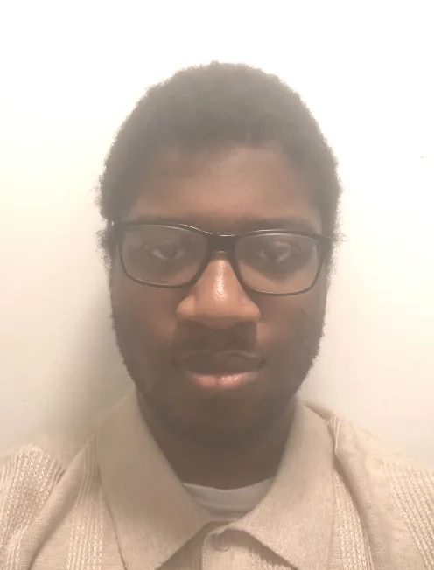
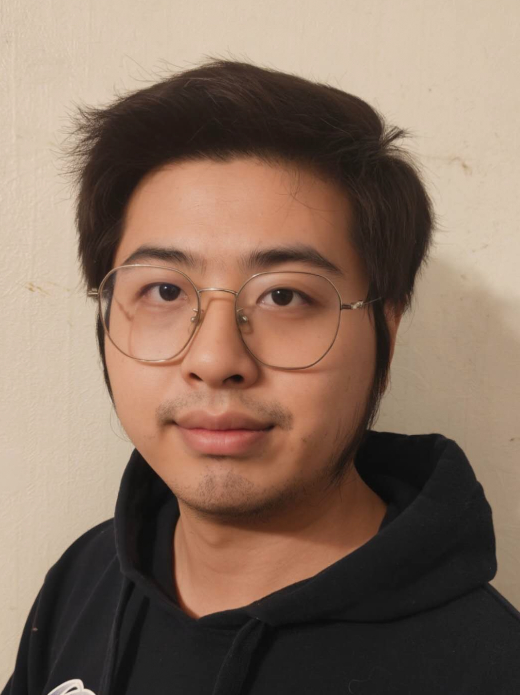
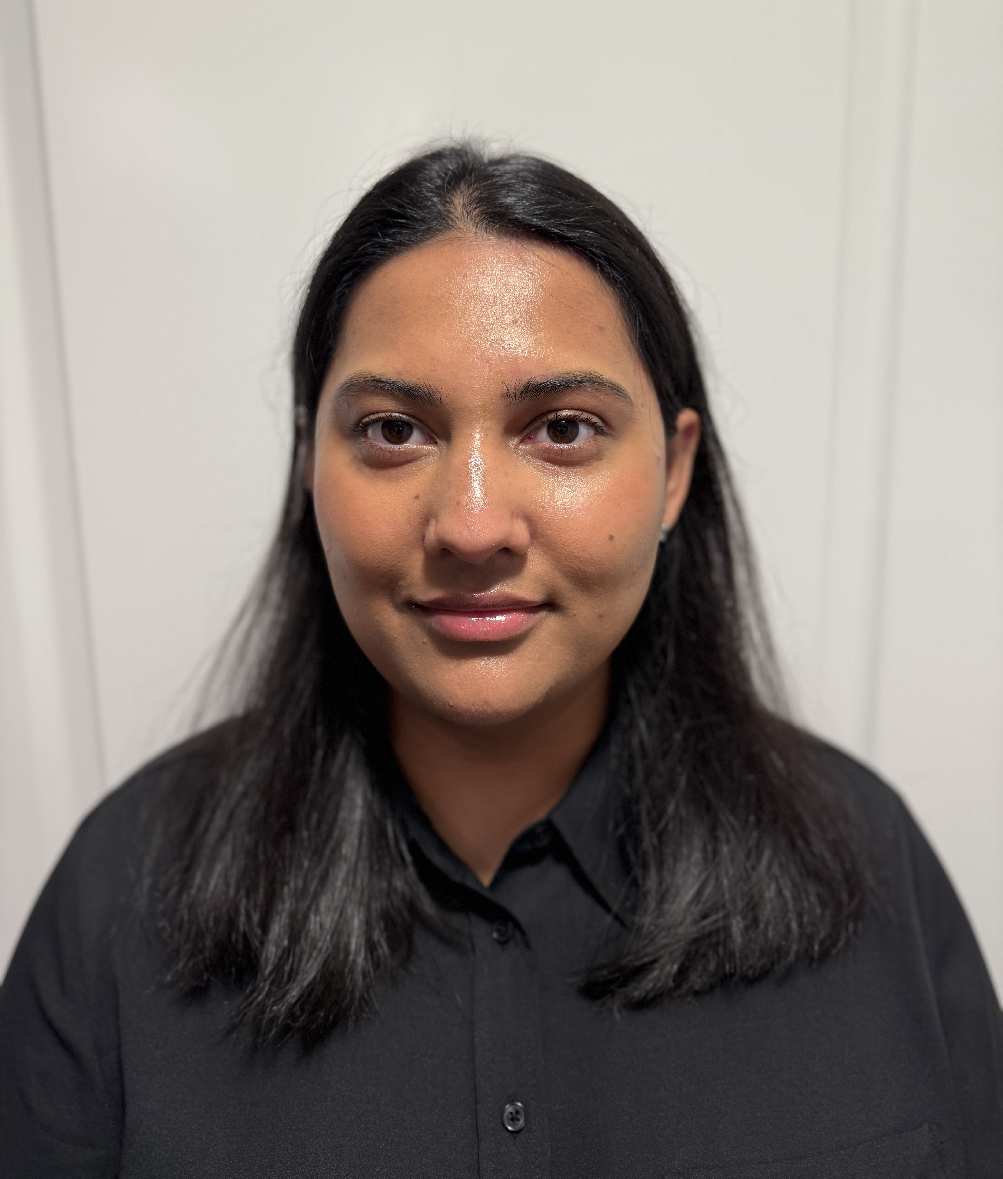

A Language-Independent Approach for Tracking Source Code Lines
COMP3110 Team 41
Emmanuel Omunua
Christian-Anthony Yager
Haoyao Sun
Ayesha Shakeel

